Slide 1
2D ROBOT MANIPULATOR VISUALIZER
TEAM LA PRIMA +
TANMAY CHINCHANIKAR
AJINKYA NANDE
SAURABH PATIL
ADITYA JOGLEKAR
BADAL PARDHI
PARTH MALPATHAK

Slide 2
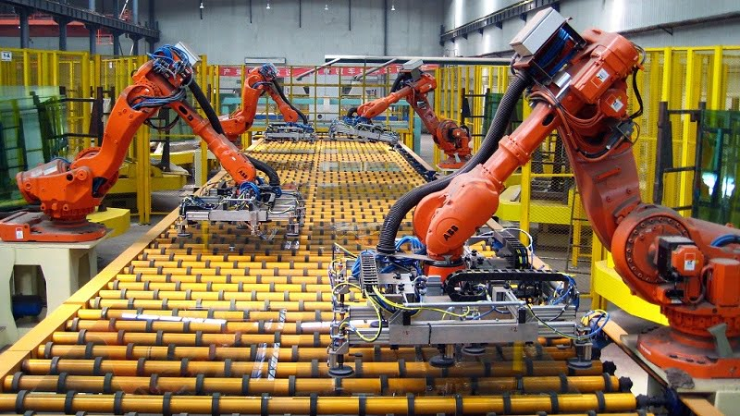
PURPOSE
To visualize the functioning of a pick and place robotic arm for students.
For the purpose of demonstration of ASRS System to the employees in the industry.
For cost saving by using simulations instead of actual machinery for demonstrational purposes.

Slide 3
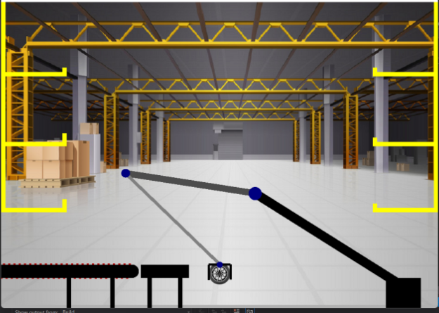
FUNCTIONALITY
The user selects the mode: automatic or manual.
The user selects the object to be placed.
Automatic mode can be used for demonstration of correct picking and placement of objects in their designated locations.
Manual mode can be used for understanding the specific functionality of robotic arm using inverse kinematics.

Slide 4
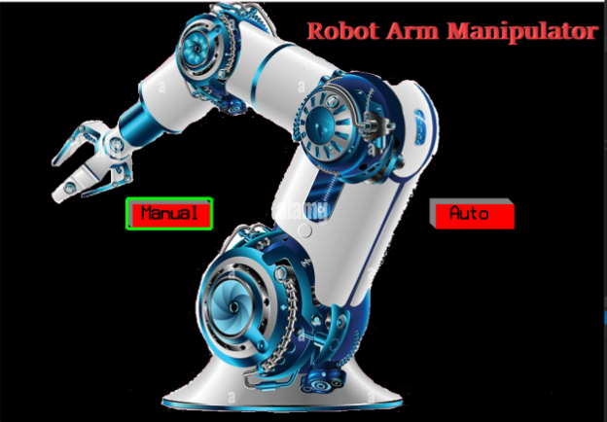
TARGET AUDIENCE
Students.
Industrial Demonstration.
Simulation training for Industry Employees.

Slide 5
CONTRIBUTIONS
TANMAY CHINCHANIKAR: Inverse kinematics code and robot arm movement
AJINKYA NANDE: End effector and conveyor belt
SAURABH PATIL: Object placement and movement
ADITYA JOGLEKAR: Object placement and movement
BADAL PARDHI: Inverse kinematics code and robot arm movement
PARTH MALPATHAK: End effector and conveyor belt
CODE INTEGRATION, FINAL FINISHES AND PRESENTATIONAL WORK DONE BY ENTIRE TEAM

Slide 6
THANK YOU!

